Slide 1
Project Title
LOAN-PREDICTION
Team Member and Roll No.
Monu Kumar(2210990583)
Muskan(2210990589)
Muskan Rehni(2210990591)
Nikhil Verma(2210990612)

Slide 2
Index
Introduction
Source Code (screenshots)
Result
Conclusion
Reference

Slide 3
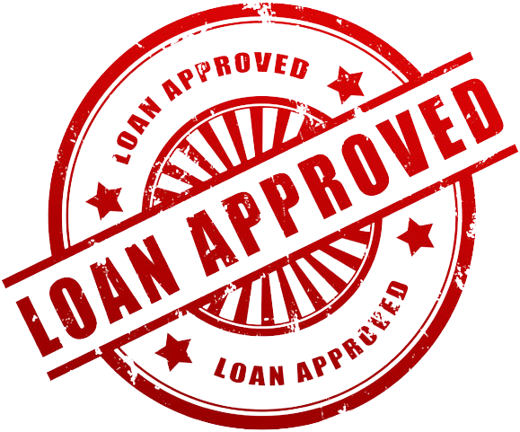
INTRODUCTION
The aim of a loan approval prediction project in machine learning is to develop a model that can predict whether a loan application should be approved or denied based on various factors. This project typically involves:
Data Collection
Data Preprocessing
Feature Selection/Engineering
Model Selection and Training
Model Evaluation:
Deployment:

Slide 4
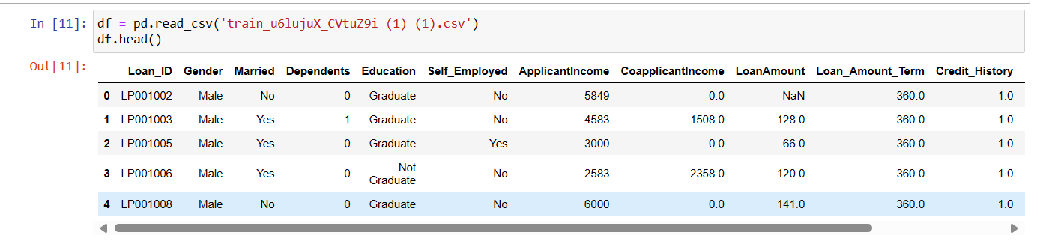
SOURCE-CODE
This is how out dataset looks:

Slide 5
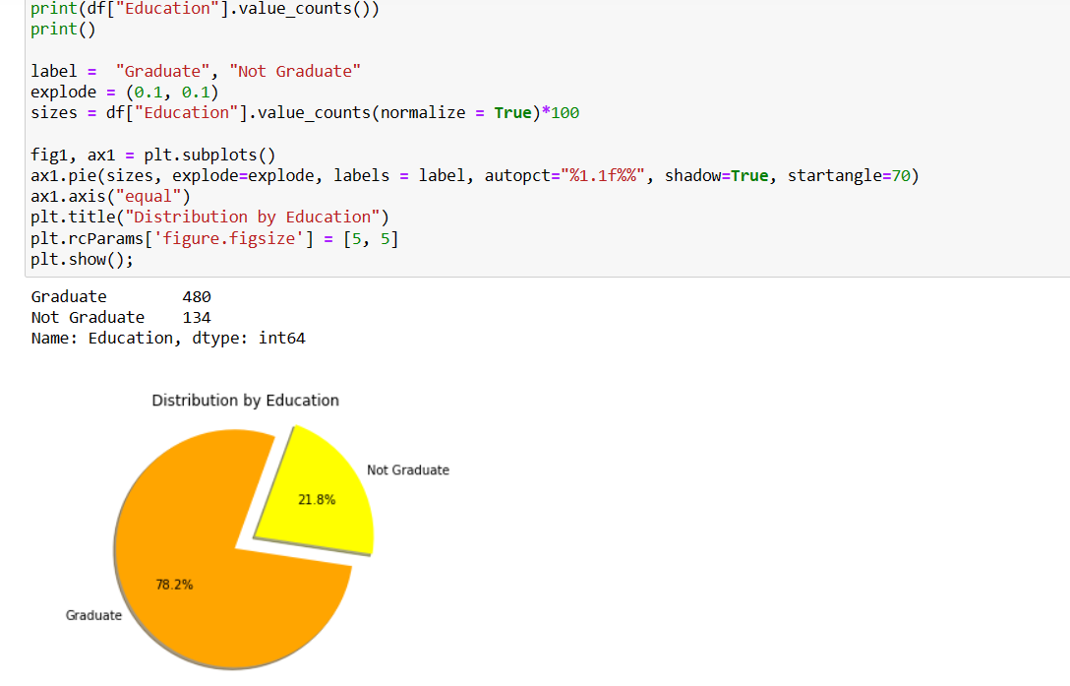
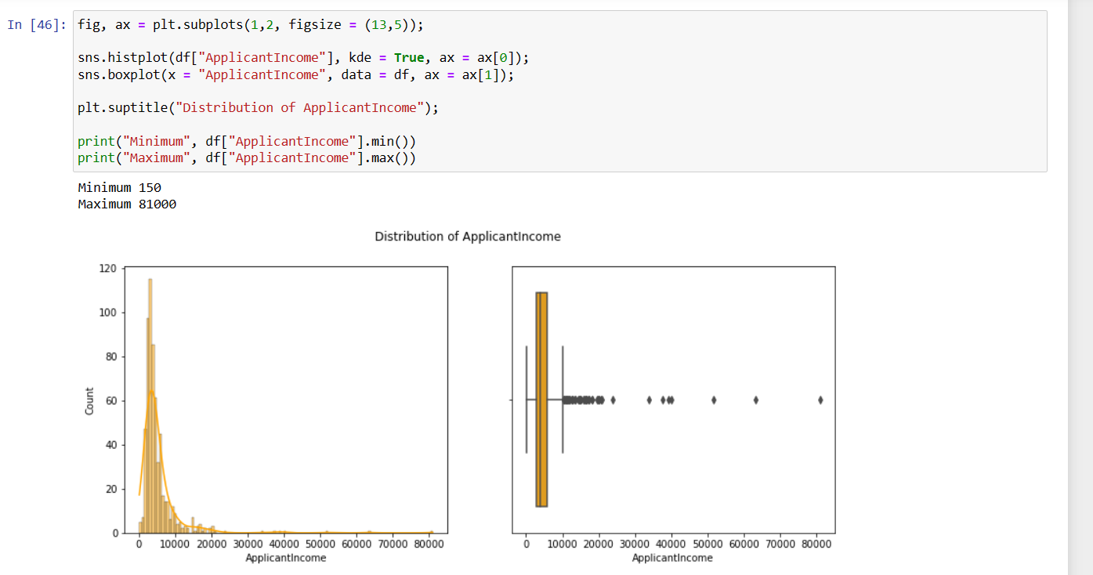
Continue..

Slide 6
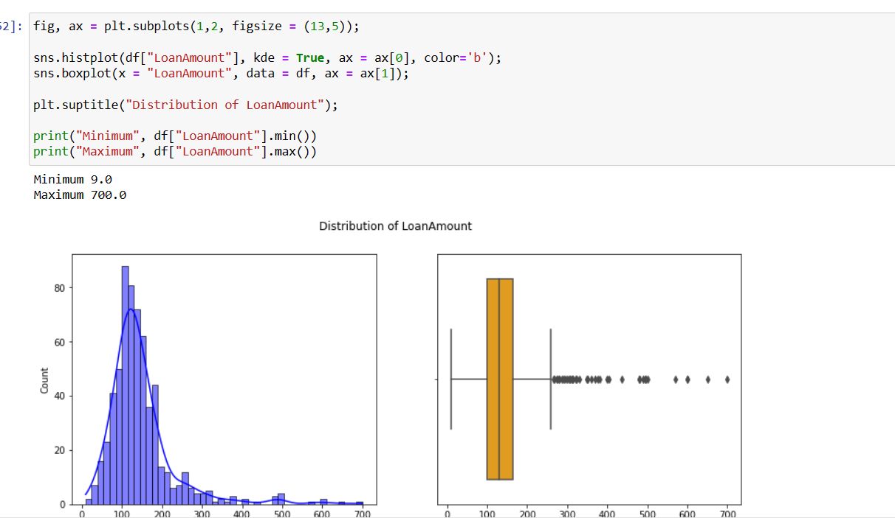
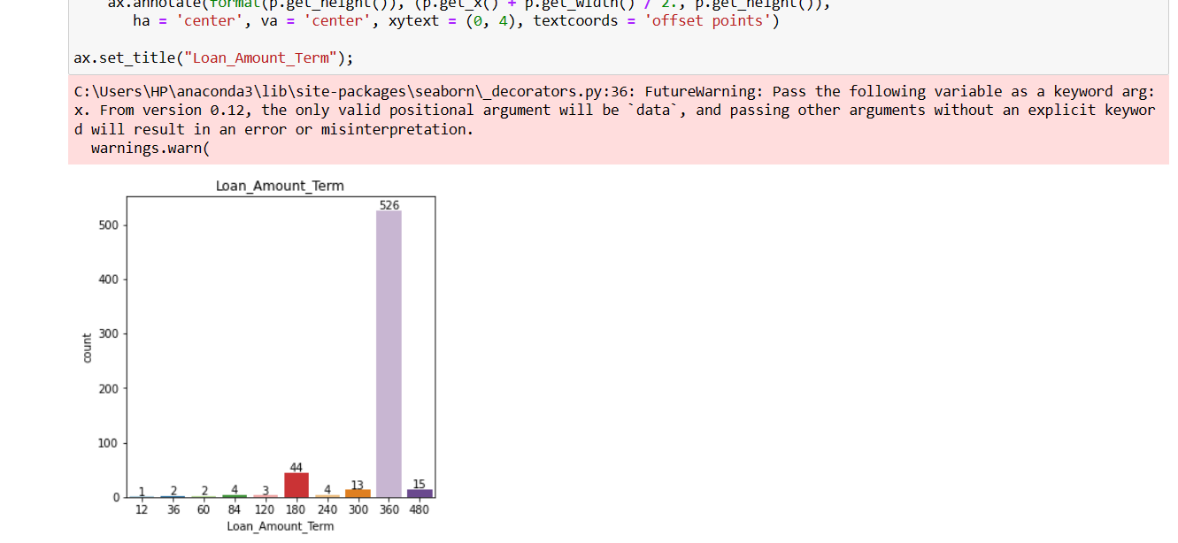
Continue…

Slide 7
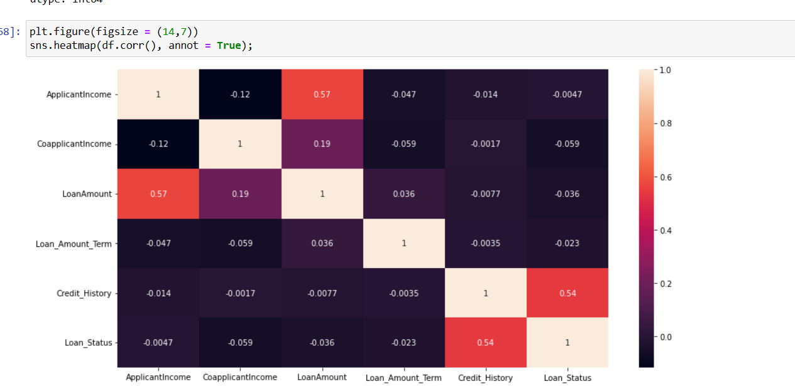
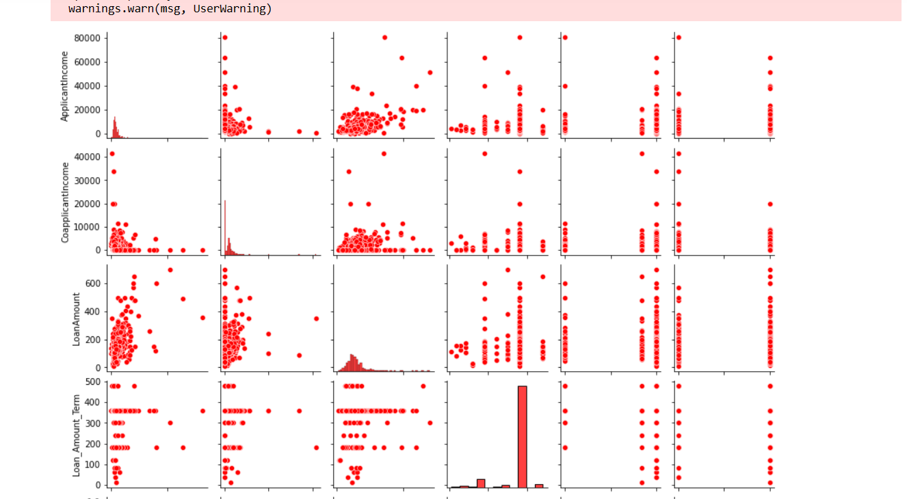
Continue…

Slide 8
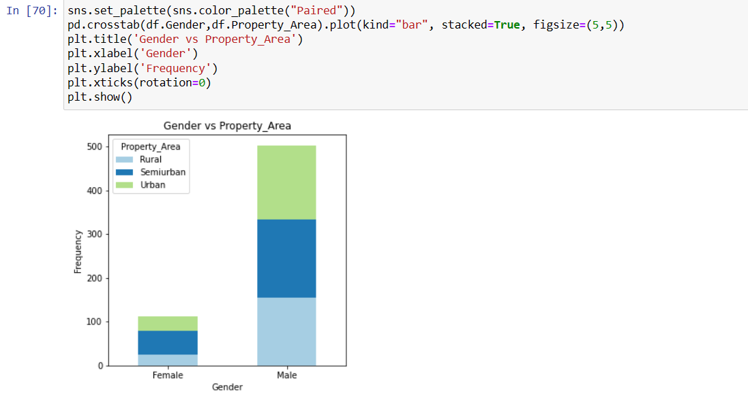
Continue..

Slide 9
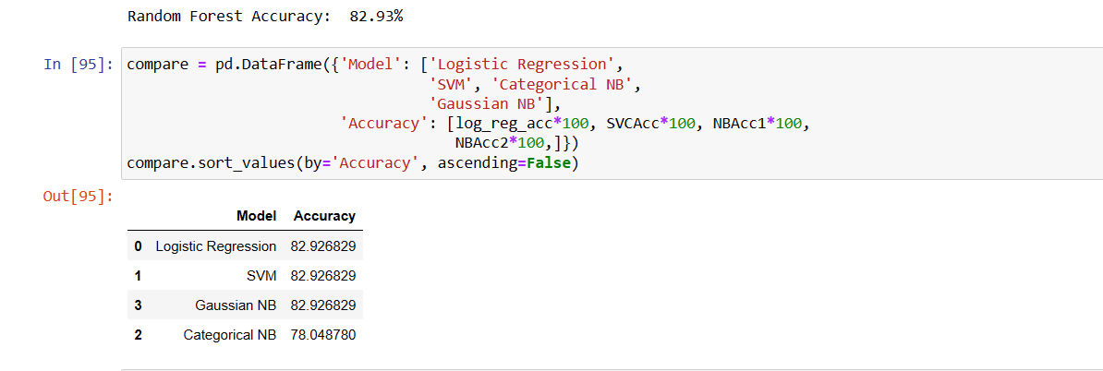
RESULT/OUTPUT

Slide 10
CONCLUSION
Through feature analysis, we identified the most influential factors affecting loan approval decisions, including credit history, income level, and loan amount. These insights can help financial institutions streamline their approval processes and make more informed decisions.
While the model shows promise, there are limitations to consider, such as the need for more diverse and up-to-date data. Future improvements could involve incorporating additional features or exploring advanced machine learning techniques to enhance predictive performance.
Overall, this project demonstrates the potential of machine learning in optimizing loan approval processes, ultimately benefiting both lenders and borrowers by improving efficiency and reducing the risk of default.

Slide 11
Reference
https://github.com/boris-quagmire/Loan-Approval-Prediction-Model-with-GUI
https://youtu.be/vSBGCf5hqDE?feature=shared

Slide 12
The End

